Slide 1
Docker Certified Associate Training
Source: https://docs.docker.com
Notes:
Mention the course name

Slide 2
Security
Notes:
Mention the topic name and convey its importance/role in brief

Slide 3

By the end of this lesson, you will be able to:
Implement Docker Security and Default Engine Security
Describe the process of signing an image
Create the UCP client bundles
Illustrate the significance of Roles and Secrets
Notes:
Explain the learning objectives

Slide 4
Docker Security

Slide 5
Docker Security
Docker security prevents a compromised container from consuming a large amount of resources for disrupting service or performing malicious activities.
The kernel's intrinsic security and support for namespaces and cgroups.
The vulnerable surface on the Docker daemon.
Things to consider when reviewing Docker Security:
The container configuration profile’s loopholes.
The kernel’s ”hardening" security features and how they interact with containers.
Notes:
Explain Docker Security and explain what is the importance of it.

Slide 6
Default Engine Security
Configures the trust features of Docker to allow users to push and pull trusted images
Protects the Docker daemon socket and ensures only trusted Docker client connections
Has the right to access images in a registry
Sets up policies to secure the system calls in a container
Notes:
Explain default engine security

Slide 7
Namespace
Docker creates namespaces in the container to provide the isolated workspace.
Docker Engine uses namespaces such as the following on Linux:
The pid namespace: Isolates the process ID
The net namespace: Manages network interfaces (net: Networking)
The ipc namespace: Manages access to IPC resources (ipc: InterProcess Communication)
The mnt namespace: Manages filesystem mount points (mnt: Mount)
The uts namespace: Isolates kernel and version identifiers (uts: Unix Timesharing System)
Notes:
Explain namespace and tell where Docker Engine uses namespaces.
Namespace: When you run a container, Docker creates a set of namespaces for that container. These namespaces provide a layer of isolation. Each aspect of a container runs in a separate namespace and its access is limited to that namespace.

Slide 8
Kernel Namespace
Docker containers are very similar to Linux containers, and they have similar security features.
Namespaces provide the first and most straightforward form of isolation, processes running within a container cannot see, and even less affect, processes running in another container, or in the host system.
Each container also gets its own network stack, meaning that a container doesn’t get privileged access to the sockets or interfaces of another container.
Notes:
Explain namespace and tell where Docker Engine uses namespaces.
Namespace: When you run a container, Docker creates a set of namespaces for that container. These namespaces provide a layer of isolation. Each aspect of a container runs in a separate namespace and its access is limited to that namespace.

Slide 9
Control Groups
Docker Engine on Linux relies on a technology called control groups (cgroups). They are a key component of Linux Containers.
Key features of control groups:
Limit an application to a particular collection of resources
Allow Docker Engine to share available container hardware resources and enforce limitations and constraints as an option
For example, the user can restrict the available space to a specific container
Implement resource accounting
Notes:
Explain control groups and explain the key features of control groups

Slide 10
Control Groups
Key features of control groups (contd.):
Provide many useful metrics
Ensure that each container gets its fair share of memory, CPU, and disk I/O
Ensure that a single container cannot bring the system down by exhausting one of the resources

Slide 11
Docker Daemon

Slide 12
Docker Daemon Attack Surface
It helps the Docker to allow the user to share a directory between the Docker host and a guest container; and it also allows the user to do so without limiting the access rights of the container.
Additional features of Docker Daemon:
Running containers (and applications) with Docker implies running the Docker daemon.
This daemon requires root privileges unless you opt-in to rootless mode (experimental).
The user should be aware of some important details:
Only trusted users should be allowed to control your Docker daemon
The daemon is potentially vulnerable to inputs, such as image loading from either disk with docker load or from the network with docker pull
Notes:
Explain docker daemon attack surface and explain the features of docker daemon.

Slide 13
Linux Kernel Capabilities

Slide 14
Linux Kernel Capabilities
Docker runs the containers with certain restricted capabilities by default. This means the root capabilities are not provided to all processes operating inside a container.
For instance it is possible to:
deny all mount operations
deny access to raw sockets
deny access to some filesystem operations, like creating new device nodes, changing the owner of files, or altering attributes
deny module loading
Notes:
This means that even if an intruder manages to escalate to root within a container, it is much harder to do serious damage, or to escalate to the host.
This doesn’t affect regular web apps, but reduces the vectors of attack by malicious users considerably. By default Docker drops all capabilities except those needed, a whitelist instead of a blacklist approach. You can see a full list of available capabilities in Linux manpages.
One primary risk with running Docker containers is that the default set of capabilities and mounts given to a container may provide incomplete isolation, either independently, or when used in combination with kernel vulnerabilities.
Docker supports the addition and removal of capabilities, allowing use of a non-default profile. This may make Docker more secure through capability removal, or less secure through the addition of capabilities. The best practice for users would be to remove all capabilities except those explicitly required for their processes.

Slide 15
Docker Content Trust

Slide 16
Docker Content Trust
Docker Content Trust (DCT) provides the ability to use digital signatures for data from remote Docker registries that are sent and received.
Image Tags and DCT:
An individual image record has the following identifier:
[REGISTRY_HOST[:REGISTRY_PORT]/]REPOSITORY[:TAG]
A particular image REPOSITORY can have multiple tags.
DCT is associated with the TAG portion of an image.
Notes:
Explain docker content trust
DCT: Such signatures enable the integrity and publisher of specific image tags to be verified on the client-side or runtime.
1st point in 1st box: An image publisher can build an image and tag combination many times changing the image with each build.
2nd point in 1st box: . Each image repository has a set of keys that image publishers use to sign an image tag. Image publishers have discretion on which tags they sign.

Slide 17
Docker Content Trust
Docker Content Trust Keys
Trust for an image tag is managed using signing keys. A key set is created when an operation using DCT is first invoked. A key set consists of the following classes of keys:
An offline key that is the root of DCT for an image tag
Repository or tagging keys that sign tags
Server-managed keys, such as the timestamp key, which provides freshness security guarantees for the repository
Notes:
Explain the docker content trust keys in details

Slide 18
Docker Content Trust
Sign Images with Docker Content Trust
The user can use the $docker trust command syntax to sign and push a container image within the Docker CLI.
A prerequisite for signing an image is a Docker Registry with an attached Notary server like the Docker Hub or Docker Trusted Registry.
The user will need a delegation key pair to sign a Docker File.
Notes:
Explain the importance of sign images with docker content trust
3rd point: These keys can be generated locally by generating a $docker trust key, generated by a certificate authority, or by using the Universal Control Plane (UCP) of Docker Enterprise, a user's Client Bundle provides adequate delegation keys.

Slide 19
Docker Content Trust
Runtime Enforcement with DCT
Docker Content Trust within the Docker Enterprise Engine prevents a user from using a container image from an unknown source, as well as prevents a user from building a container image from an unknown source.
Engine Signature Verification prevents the following:
$ docker container run of an unsigned or altered image.
$ docker pull of an unsigned or altered image.
$docker build where there is no FROM image signed or scratched.
Notes:
Explain the importance of runtime enforcement with docker content trust

Slide 20
Docker Content Trust
Enabling DCT within the Docker Enterprise Engine
DCT is controlled by the Docker Engine’s configuration file.
The content-trust flag is based on a mode variable instructing the engine whether to implement signed images. The trustpinning variable tells the engine what sources to trust.
Disabled
Permissive
Mode can take three variables
Enforced
Notes:
Explain each of the following:
Disabled: Verification is not active, and the remainder of the content-trust related metadata will be ignored. This is the default value if mode is not specified.
Permissive: Verification will be performed, but only failures will be logged and remain unenforced. This configuration is intended for testing of changes related to content-trust. The results of the signature verification is displayed in the Docker Engine’s daemon logs.
Enforced: Content trust will be enforced and an image that cannot be verified successfully will not be pulled or run.

Slide 21
Docker Content Trust Signature Verification
It is a feature that allows the Docker Engine to run signed images.
How is it implemented?
Built directly into the dockerd binary
Configured in the Dockerd configuration file
Notes:
Explain how Docker Content Trust Signature Verification works

Slide 22
Docker Content Trust Signature Verification
Advantages
Allows to pull out and run repositories signed with a user-specified root key
Trustpinning can be configured in daemon.json to allow this function
Provides administrators with more information to implement and perform image signature validation with the CLI
Notes:
Explain the advantages of Docker Content Trust Signature Verification

Slide 23
Sign an Image

Slide 24
Sign an Image
The user can configure the Docker CLI client to sign the images that the user pushes to DTR. This allows whoever pulls the image to validate if they are getting the image that is created, or a forged one.
To sign an image, the user can run:
export DOCKER_CONTENT_TRUST=1
docker push <dtr-domain>/<repository>/<image>:<tag>
The above command pushes the image to DTR and creates trust metadata. It also creates public and private key pairs to sign the trust metadata and push that metadata to the Notary Server internal to DTR.
Notes:
Explain the signing an image
Sign an Image is a feature of Docker Enterprie

Slide 25
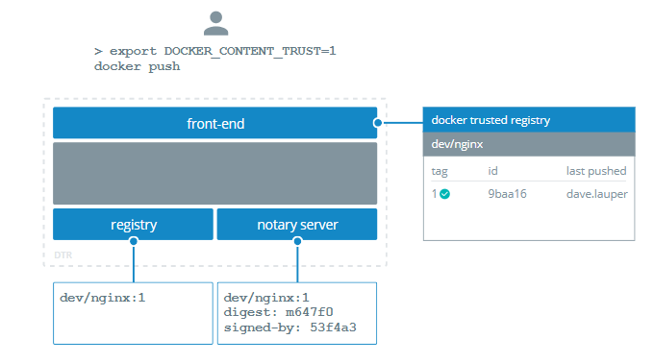
Sign an Image
Docker Trusted Registry (DTR) is the enterprise-grade image storage solution from Docker.
The Notary server manages JSON formatted TUF (The Update Framework) metadata for Notary clients and the docker command line tool's Docker Content Trust features.
Source: https://docs.docker.com/v17.09/datacenter/dtr/2.2/guides/user/manage-images/sign-images/
Notes:
Explain the diagram
That's how it looks when the client can sign an image.

Slide 26
Sign Images that UCP Can Trust
The user can sign the DTR images now, but UCP (Universal Control Panel) won’t trust them because it can’t tie the private key, which the user will use to sign the images to the UCP account.
To sign images in a way that UCP trusts them, the user needs to:
Configure the Notary client
Initialize trust metadata for the repository
Delegate signing to the keys in the UCP client bundle
Notes:
Explain the sign images that UCP can trust

Slide 27
Describe the Process of Signing an Image
Problem Statement: Your supervisor has asked you to push an image to DTR and sign it with Docker CLI so that it can be trusted by UCP and scanned for vulnerabilities.
Steps to Perform:
Download the notary CLI client, make it executable, and move it to your location.
Pull an nginx image from the Docker CLI client and tag it.
Log in to DTR with your admin credentials.
Sign and push the image to DTR.

Slide 28
Vulnerabilities
Docker image security best practices:
Prefer minimal base images
Use fixed tags for immutability
Sign and verify images to mitigate MITM attack
Use COPY instead of ADD
Find, fix, and monitor for open source vulnerabilities
Use labels for metadata
Don’t leak sensitive information to docker images
Use multi-stage builds for small secure images
Create a dedicated user with minimal permissions
Use a linter
Notes:
Explain what is vulnerabilities and explain the points in details

Slide 29
Scan Images for Vulnerabilities
Docker Trusted Registry can scan images in the repositories using Docker Security Scanning, to verify that they are free from known security vulnerabilities or exposures.
Docker Security Scan process:
DTR scans both Linux and Windows images, but by default Docker doesn’t push foreign image layers for Windows images so that DTR is not able to scan them.
If the user wants DTR to scan the Windows images, the user will have to configure Docker to always push non-foreign layers and scan them.
Notes:
Explain how Docker Trusted Registry can scan images and explain docker security scan process
The results of these scans are reported in a repository for each image tag.
Note: Scans run either on demand when you click the Scan button that is Manual scanning, or automatically on any docker push to the repository.

Slide 30
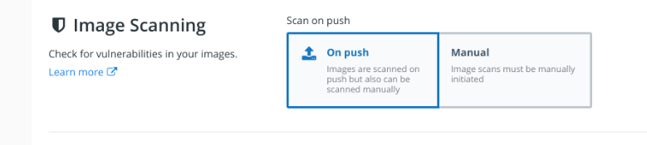


Scan Images for Vulnerabilities
Security scan on push
Manual Scanning
Manual Scanning can start scanning images manually in repositories to which the user has write access.
Docker Security Scanning runs automatically on docker push to an image repository by default.
Source: https://docs.docker.com/ee/dtr/user/manage-images/scan-images-for-vulnerabilities/#manual-scanning
Notes:
Explain scan images for vulnerabilities
Security scan on push: If your DTR instance is configured in this way, you do not need to do anything once your docker push completes. The scan runs automatically, and the results are reported in the repository’s Tags tab after the scan finishes.

Slide 31
Demonstrate an Image Passing Security Scan
Problem Statement: You have been asked by your team lead to scan an image for vulnerabilities in DTR that can be fixed later.
Steps to Perform:
Sign in to DTR with your admin credentials and navigate to Security tab.
Click the Enable Scanning button to enable image scanning.
Click Enable Online Syncing to automatically scan an image while pushing it.
Set Scanning Mode to On Push or Manual while creating repositories.

Slide 32
Client Bundle

Slide 33
Client Bundle
A client bundle is a group of certificates downloadable directly from the Docker Universal Control Plane (UCP) user interface within the admin section for “My Profile.”
Admin user certificate bundles: Allow the running of docker commands on the Docker Engine of any node
User certificate bundles: Only allow running docker commands through a UCP controller node
UCP Client Bundles
Notes:
Explain client bundle and the types of client bundle
Client bundle: A client bundle contains a private and public key pair that authorizes your requests in UCP. It also contains utility scripts that you can use to configure your client tools for Docker to talk to your UCP deployment.

Slide 34
Features of UCP
Universal control plane overview
Centralized cluster management
specified either as a string containing a path to the build context
Docker Universal Control Plane (UCP) is the enterprise-grade cluster management solution from Docker.
Deploy, manage, and monitor
Built-in security and access control
Use the Docker CLI client
Notes:
Explain the features of UCP
Universal Control Plane overview: You install it on-premises or in your virtual private cloud, and through a single interface, it helps you control your Docker cluster and applications.

Slide 35
Features of UCP
Universal control plane overview
Centralized cluster management
specified either as a string containing a path to the build context
Centralized cluster management helps the user to join up to thousands of physical or virtual machines together with Docker to create a container cluster that enables the user to deploy their applications on a scale.
Deploy, manage, and monitor
Built-in security and access control
Use the Docker CLI client
Notes:
Explain the features of UCP
Centralized cluster management: Docker Universal Control Plane extends the functionality provided by Docker to make it easier to manage your cluster from a centralized place. The user can manage and monitor your container cluster using a graphical UI.

Slide 36
Features of UCP
Universal control plane overview
Centralized cluster management
specified either as a string containing a path to the build context
The user can deploy, manage, and monitor all the computing resources that are available from a centralized location, such as clusters, volumes, and networks with Docker UCP.
Deploy, manage, and monitor
Built-in security and access control
Use the Docker CLI client
Notes:
Explain the features of UCP

Slide 37
Features of UCP
Universal control plane overview
Centralized cluster management
specified either as a string containing a path to the build context
Docker UCP has an integrated authentication mechanism of its own and is integrated with LDAP services. It also has Roll-Based Access Control (RBAC), which enables the user to control who can access and make changes to their cluster and applications.
Deploy, manage, and monitor
Built-in security and access control
Use the Docker CLI client
Notes:
Explain the features of UCP

Slide 38
Features of UCP
Universal control plane overview
Centralized cluster management
specified either as a string containing a path to the build context
The user can continue to deploy and manage their applications including the Docker CLI client because UCP exposes the standard Docker API.
Deploy, manage, and monitor
Built-in security and access control
Use the Docker CLI client
Notes:
Explain the features of UCP
Use the Docker CLI client: For example, the user can use the docker info command to check the status of a cluster that’s managed by UCP.

Slide 39
Integrate UCP with LDAP
Docker UCP integrates with LDAP (Lightweight Directory Access Protocol) directory services, so that the user can manage users and groups from their organization’s directory, and it will automatically propagate that information to UCP and DTR.
The user can control how UCP integrates with LDAP by creating user searches.
The user can specify multiple search configurations.
The user can specify multiple LDAP servers for integration.
The user can start searches with the Base DN, which is the distinguished name of the node in the LDAP directory tree where the search starts looking for users.
Notes:
Expl how UCP integrates with LDAP

Slide 40
Integrate UCP with LDAP
Two sections for controlling LDAP searches and servers
This is the section of the Authentication and Authorization page where the user specifies search parameters, like Base DN, scope, filter, the username attribute, and the full name attribute.
This is the section where the user specifies the URL of an LDAP server, TLS configuration, and credentials for doing the search requests.
LDAP user search configurations
LDAP
Server
Notes:
Explain two sections for controlling LDAP searches and serves

Slide 41
Integrate UCP with LDAP
UCP creates a set of search results by iterating over each of the user search configs, in the order that the user specifies.
UCP chooses an LDAP server from the list of domain servers by considering the Base DN from the user search config and selecting the domain server that has the longest domain suffix match.
UCP integrates with LDAP
UCP combines the search results into a list of users and creates UCP accounts for them.
UCP uses the default domain server if no domain server has a domain suffix that matches the Base DN from the search configuration.
Notes:
Explain how UCP integrates with LDAP

Slide 42
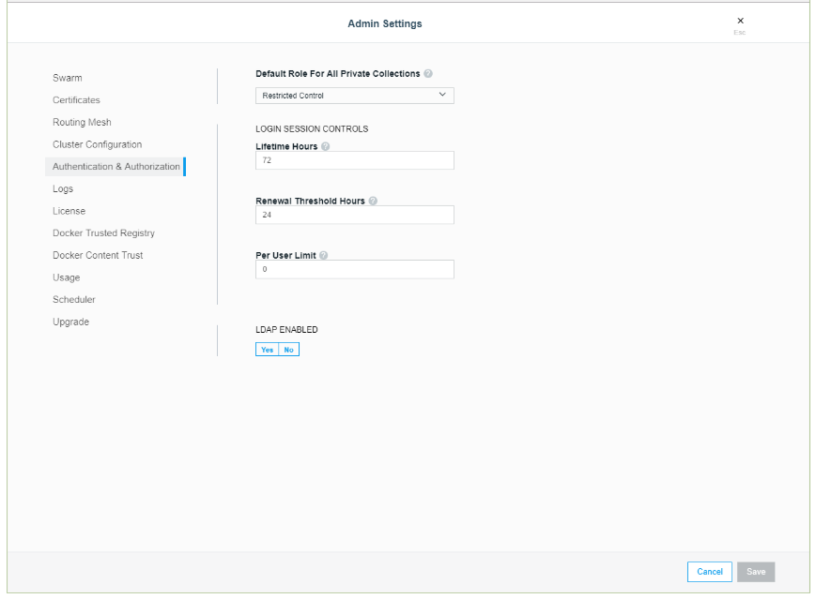
Configure the LDAP Integration
To configure UCP to create and authenticate users by using an LDAP directory, go to the UCP web UI, navigate to the Admin Settings page, and click Authentication & Authorization to select the method used to create and authenticate users.
Source: https://docs.docker.com/datacenter/ucp/2.2/guides/admin/configure/external-auth/
Notes:
Explain how to configure the LDAP integration

Slide 43
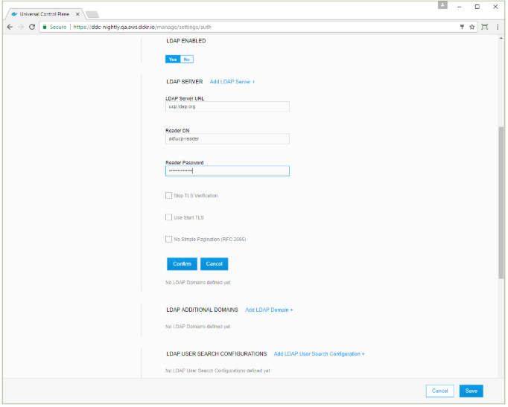
LDAP Enabled
Default role for all private collections:
Use this setting to change the default permissions of new users. Click the dropdown to select the permission level that UCP assigns by default to the private collections of new users.
LDAP enabled:
Click Yes to enable integrating UCP users and teams with LDAP servers.
Source: https://docs.docker.com/datacenter/ucp/2.2/guides/admin/configure/external-auth/
Notes:
Explain how to enable the LDAP
Default role for all private collections: Docker EE enables controlling access to container resources by using collections. A collection is a group of swarm resources, like services, containers, volumes, networks, and secrets. For example, if you change the value to View Only, all users who log in for the first time after the setting is changed have View Only access to their private collections, but permissions remain unchanged for all existing users.
The details is covered in Dock

Slide 44
LDAP Server
Field | Description
LDAP server URL | The URL where the LDAP server can be reached.
Reader DN | The distinguished LDAP account name used in the LDAP server to search for entries. This should be a read-only client of LDAP as a best practice.
Reader password | The password of the account used for searching entries in the LDAP server.
Use Start TLS | The connection can be authenticated/encrypted only after connecting to the LDAP server over TCP.
Skip TLS verification | The LDAP server certificate will be verified using TLS.
No simple pagination | The LDAP server doesn’t support pagination.
Just-in-Time User Provisioning | The user can create user accounts only when users log in for the first time.
Notes:
Explain the points of LDAP Server

Slide 45
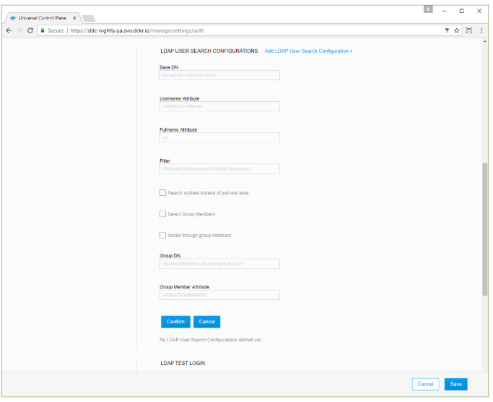
LDAP User Search Configurations
To configure more user search queries, click Add LDAP User Search Configuration again.
Source: https://docs.docker.com/datacenter/ucp/2.2/guides/admin/configure/external-auth/
Notes:
Explain LDAP User Search Configuration
This is useful in cases where users may be found in multiple distinct subtrees of your organization’s directory. Any user entry which matches at least one of the search configurations will be synced as a user.

Slide 46
LDAP User Search Configurations
Field | Description
Base DN | The distinguished name of the node in the directory tree where the search should start looking for users.
Username attribute | The LDAP attribute to use as username on UCP.
Full name attribute | The LDAP attribute to use as the user’s full name for display purposes.
Filter | The LDAP search filter used to find users.
Search subtree instead of just one level | The LDAP can be performed by searching on a single level of the LDAP tree, or searching through the full LDAP tree starting at the Base DN.
Select Group Members | This feature is helpful if the LDAP server does not support memberOf search filters.
Notes:
Explain the points of LDAP User Search Configurations
Username attribute: Only user entries with a valid username will be created.
Full name attribute: If left empty, UCP will not create new users with a full name value.

Slide 47
LDAP User Search Configurations
Field | Description
Iterate through group members | This option searches for users by first iterating over the target group’s membership, making a separate LDAP query for each member if Select Group Members is selected.
Group DN | This specifies the distinguished name of the group from which to select users if Select Group Members is selected.
Group Member Attribute | The value of this group attribute corresponds to the distinguished names of the members of the group if Select Group Members is selected.
Notes:
Explain the points of LDAP User Search Configurations

Slide 48
LDAP Test Login
Field | Description
Username | An LDAP username for testing authentication to this application. This value corresponds with the Username Attribute specified in the LDAP user search configurations section.
Password | The user’s password is used to authenticate (BIND) to the directory server.
Before the user saves the configuration changes, test that the integration is configured correctly. To do this, provide the LDAP user credentials and click on the Test button.
Notes:
Explain the points of LDAP Test Login

Slide 49
LDAP Sync Configuration
Field | Description
Sync interval | This interval between UCP and the LDAP server helps users to synchronize in hours.
Enable sync of admin users | This option specifies that system admins should be synced directly with members of a group in the organization’s LDAP directory.
Notes:
Explain the points of LDAP Sync Configuration
Once you’ve configured the LDAP integration, UCP synchronizes users based on the interval you’ve defined starting at the top of the hour. When the synchronization runs, UCP stores logs that can help you troubleshoot when something goes wrong.
You can also manually synchronize users by clicking Sync Now.

Slide 50
LDAP Sync Configuration
When a user is removed from LDAP, the effect on the user’s UCP account depends on the Just-in-Time User Provisioning setting:
Just-in-Time User Provisioning is false: Users deleted from LDAP become inactive in UCP after the next LDAP synchronization runs.
Just-in-Time User Provisioning is true: Users deleted from LDAP can’t authenticate, but their UCP accounts remain active.
Notes:
Explain LDAP Sync Configuration

Slide 51
LDAP Sync Configuration
UCP saves a minimum amount of user data required to operate.
UCP does not store any additional data from the directory server.
UCP enables syncing teams with a search query or group in the organization’s LDAP directory.
Notes:
Explain LDAP Sync Configuration
1st point: This includes the value of the username and full name attributes that the user have specified in the configuration as well as the distinguished name of each synced user.

Slide 52
Create UCP Client Bundles
Problem Statement: Your manager has asked you to create UCP client bundles that help run Docker commands on a UCP node.
Steps to Perform:
Sign in to Docker UCP with your admin credentials and navigate to My Profile.
Click on New Client Bundle dropdown and select Generate Client Bundle to download the certificate bundle.
Unzip the client-bundle.zip file and start the client certificates.
Use Docker CLI with client certificates.

Slide 53
UCP: Manager and Worker Nodes

Slide 54
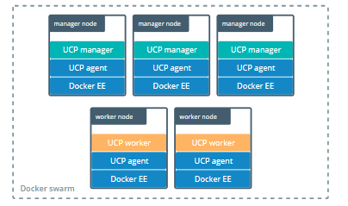
UCP: Manager and Worker Nodes
A swarm is a collection of nodes that are in the same Docker cluster. Nodes in a Docker swarm operate in one of two nodes: Manager or Worker.
Source: https://docs.docker.com/datacenter/ucp/2.2/guides/architecture/#under-the-hood
Notes:
Explain what is swarm and the two nodes: Manager and Worker
Docker UCP leverages the clustering and orchestration functionality provided by Docker.
When nodes do not already run in a swarm once UCP is installed, nodes are configured to run in swarm mode. When nodes do not already run in a swarm once UCP is installed, nodes are configured to run in swarm mode.
When you deploy UCP, it starts running a globally scheduled service called ucp-agent. This service monitors the node where it’s running and starts and stops UCP services, based on whether the node is a manager or a worker node.

Slide 55
UCP: Manager and Worker Nodes
Managers
Workers
The ucp-agent service starts to serve all UCP components automatically, including the UCP Web UI and data stores used by UCP. This is accomplished by the ucp-agent by deploying several containers on the node. UCP automatically becomes highly available and fault tolerant by promoting a node to the manager.
The ucp-agent service starts to provide a proxy network on the worker nodes, ensuring that only authorized users and other UCP services can execute Docker commands in that node. The ucp-agent deploys a subset of containers on worker nodes.
Notes:
Explain the difference between managers and workers

Slide 56
UCP Components in Manager Nodes
UCP Component | Description
ucp-agent | The running service monitors the node and ensures the right UCP services are present.
ucp-reconcile | The ucp-agent detects that the node is not running the right UCP components. The ucp-reconcile container starts to converge the node to its desired state.
ucp-auth-api | The centralized service for identity and authentication used by UCP and DTR.
ucp-auth-store | The service stores authentication configurations and data for users, organizations, and teams.
ucp-auth-worker | The service performs scheduled LDAP synchronizations and cleans authentication and authorization data.
ucp-client-root-ca | A certificate authority to sign client bundles.
ucp-cluster-root-ca | A certificate authority used for TLS communication between UCP components.
Notes:
Explain the UCP components in Manager Nodes

Slide 57
UCP Components in Manager Nodes
UCP Component | Description
ucp-controller | It is a UCP web server.
ucp-dsinfo | It helps Docker system information collection script to assist with troubleshooting.
ucp-kv | It is used to store the UCP configurations. It can’t be used in the applications, since it’s for internal use only.
ucp-metrics | It is used to collect and process metrics for a node, like the disk space available.
ucp-proxy | It is a TLS proxy. It allows secure access to the local Docker Engine to UCP components.
ucp-swarm-manager | It is used to provide backwards-compatibility with Docker Swarm.
Notes:
Explain the UCP components in Manager Nodes

Slide 58
UCP Components in Worker Nodes
UCP Component | Description
ucp-agent | It is the service that runs and monitors the node and ensures the right UCP services.
ucp-dsinfo | It is the Docker system information collection script that assists with troubleshooting.
ucp-reconcile | It is the ucp-agent that detects that the node is not running the right UCP components. The ucp-reconcile container starts to converge the node to its desired state.
ucp-proxy | It is a TLS proxy. It allows secure access to the local Docker Engine to UCP components.
Notes:
Explain the UCP components in Worker Nodes

Slide 59
Configuration of Certificates

Slide 60
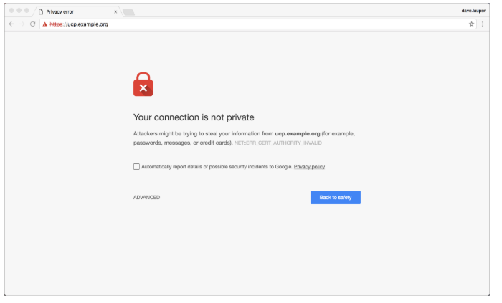
External Certificates with UCP
Use TLS Certificates
To ensure that all communications between clients and UCP are encrypted, all UCP services are exposed using HTTPS.
Source: https://docs.docker.com/datacenter/ucp/2.2/guides/admin/configure/use-your-own-tls-certificates/
Notes:
Explain the use of TLS Certificates
This is done by default using self-signed TLS certificates that client tools such as web browsers do not trust. So when you try to access UCP, your browser warns that it doesn’t trust UCP or that UCP has an invalid certificate.

Slide 61
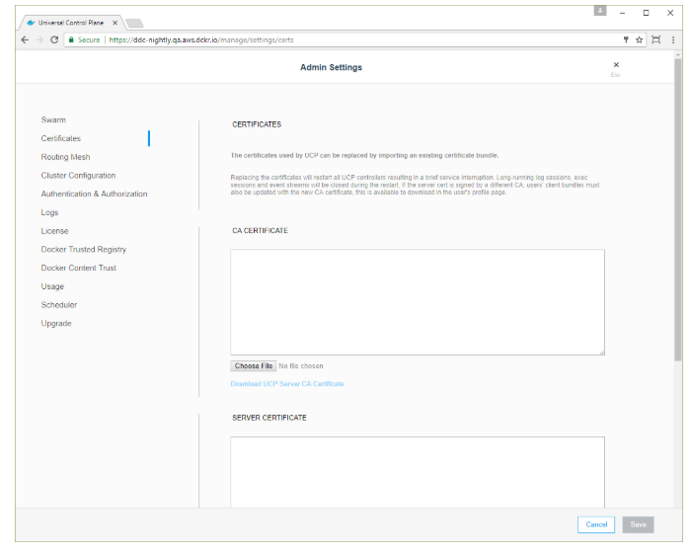
External Certificates with UCP
Configure UCP to use TLS certificates and keys
In the UCP web UI, log in with administrator credentials and navigate to the Admin Settings page.
In the left pane, click Certificates.
Source: https://docs.docker.com/datacenter/ucp/2.2/guides/admin/configure/use-your-own-tls-certificates/
Notes:
Explain how to configure UCP to use TLS certificates and keys
Finally, click Save for the changes to take effect.
After replacing the TLS certificates, users can’t authenticate with their old client certificate bundles.
Ask the users to go to the UCP web UI and get new client certificate bundles.

Slide 62
External Certificates with UCP
Upload the following certificates and keys:
A ca.pem file with the root CA public certificate.
A cert.pem file containing the domain TLS certificate and any intermediate public certificate.
A key.pem file with TLS private key. Make sure it is not encrypted with a password. Encrypted keys should have ENCRYPTED in the first line.
Notes:
Explain external certificates with UCP

Slide 63
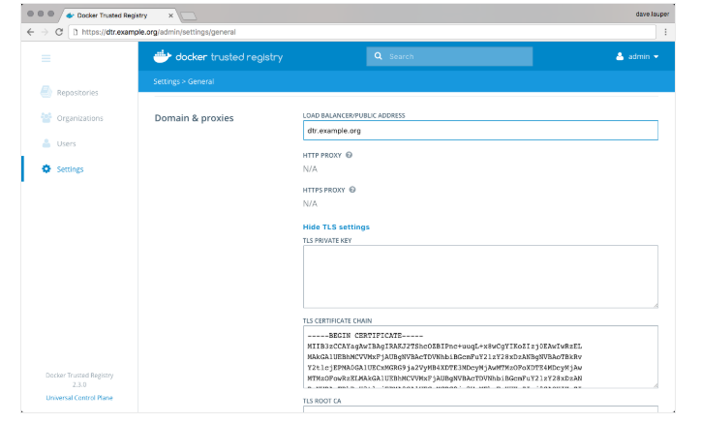
External Certificates with DTR
Replace the server certificates
To configure DTR to use the certificates and keys, go to the DTR web UI, navigate to the Settings page, and scroll down to the Domain section.
Source: https://docs.docker.com/datacenter/dtr/2.3/guides/admin/configure/use-your-own-tls-certificates/
Notes:
Explain external certificates with DTR
Finally, click Save for the changes to take effect. UCP trusts DTR
If you’re using certificates issued by a globally trusted certificate authority, any web browser or client tool should now trust DTR. If you’re using an internal certificate authority, you need to configure your system to trust that certificate authority.

Slide 64
External Certificates with DTR
Upload the following certificates and keys:
Load balancer/public address: This is the domain name client that will help to access DTR.
TLS certificate: This is the server certificate.
TLS private key: This is the server private key.
TLS CA: This is the root CA public certificate.
Notes:
Explain external certificates with DTR

Slide 65
Configuration of Certificates
Understanding the Configuration
A custom certificate is configured by creating a directory under /etc/docker/certs.d using the same name as the registry’s hostname, such as localhost. All *.crt files are added to this directory as CA roots.
The presence of one or more <filename>.key/cert pairs in Docker indicates that there are custom certificates required for access to the desired repository.
Notes:
Explain the configuration of certificates
Read the first box then:
Note: As of Docker 1.13, on Linux any root certificates authorities are merged with the system defaults, including as the host’s root CA set. On prior versions of Docker, and on Docker Enterprise Edition for Windows Server, the system default certificates are only used when no custom root certificates are configured.

Slide 66
Configuration of Certificates
The following illustrates a configuration with custom certificates:
/etc/docker/certs.d/ <-- Certificate directory
└── localhost:5000 <-- Hostname:port
├── client.cert <-- Client certificate
├── client.key <-- Client key
└── ca.crt <-- Certificate authority that signed the registry certificate
Notes:
Explain the configuration of certificates
The preceding example is operating-system specific and is for illustrative purposes only. You should consult your operating system documentation for creating an os-provided bundled certificate chain.

Slide 67
Configuration of Certificates
Create the client certificates
Use OpenSSL’s genrsa and req commands to first generate an RSA key and then use the key to create the certificate.
$ openssl genrsa -out client.key 4096
$ openssl req -new -x509 -text -key client.key -out client.cert
Note: These TLS commands only generate a working set of certificates on Linux. The version of OpenSSL in macOS is incompatible with the type of certificate Docker requires.
Notes:
Explain the configuration of certificates

Slide 68
Configuration of Certificates
Troubleshooting tips
The Docker daemon interprets .crt files as CA certificates and .cert files as client certificates. The Docker daemon logs the following error message if a CA certificate is accidentally given the .cert extension instead of the correct .crt extension:
Missing key KEY_NAME for client certificate CERT_NAME. CA certificates should use the extension .crt.
Notes:
Explain the configuration of certificates

Slide 69
Configuration of Certificates
If the Docker registry is accessed without a port number, do not add the port to the directory name. The following shows the configuration for a registry on default port 443 which is accessed with docker login my-https.registry.example.com:
/etc/docker/certs.d/
└── my-https.registry.example.com <-- Hostname without port
├── client.cert
├── client.key
└── ca.crt
Notes:
Explain the configuration of certificates

Slide 70
Swarm Security and TLS

Slide 71
Swarm Security
The swarm mode public key infrastructure (PKI) system built into Docker makes it simple to securely deploy a container orchestration system.
The nodes in a swarm use mutual Transport Layer Security (TLS) to authenticate, authorize, and encrypt the communications with other nodes in the swarm.
When the user creates a swarm by running docker swarm init, Docker designates itself as a manager node.
The user can specify their own externally-generated root CA, using the --external-ca flag of the docker swarm init command.
Notes:
Each token includes the digest of the root CA’s certificate and a randomly generated secret. When a node joins the swarm, the joining node uses the digest to validate the root CA certificate from the remote manager. The remote manager uses the secret to ensure the joining node is an approved node.
Each time a new node joins the swarm, the manager issues a certificate to the node. The certificate contains a randomly generated node ID to identify the node under the certificate common name (CN) and the role under the organizational unit (OU). The node ID serves as the cryptographically secure node identity for the lifetime of the node in the current swarm.

Slide 72
Swarm Security
The manager node also generates two tokens to use when the user joins additional nodes to the swarm:
Worker Token
Manager Token
Notes:
Explain swarm security
Each token includes the digest of the root CA’s certificate and a randomly generated secret. When a node joins the swarm, the joining node uses the digest to validate the root CA certificate from the remote manager. The remote manager uses the secret to ensure the joining node is an approved node.
Each time a new node joins the swarm, the manager issues a certificate to the node. The certificate contains a randomly generated node ID to identify the node under the certificate common name (CN) and the role under the organizational unit (OU). The node ID serves as the cryptographically secure node identity for the lifetime of the node in the current swarm.

Slide 73
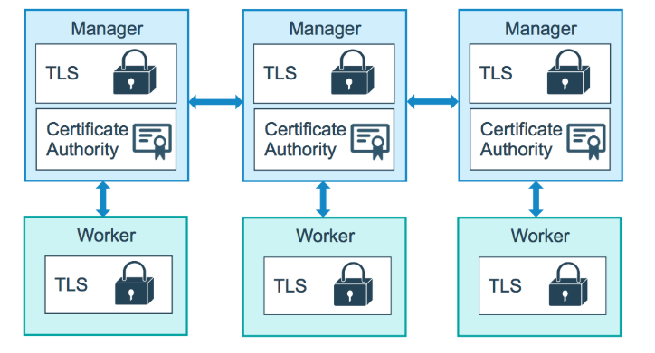
Swarm Security
The diagram below illustrates how manager nodes and worker nodes encrypt communications using a minimum of TLS 1.2.
Source: https://docs.docker.com/datacenter/dtr/2.3/guides/admin/configure/use-your-own-tls-certificates/
Notes:
Explain the diagram

Slide 74
Swarm Security
The example below shows the information from a certificate of a worker node:
Certificate:
Data:
Version: 3 (0x2)
Serial Number:
3b:1c:06:91:73:fb:16:ff:69:c3:f7:a2:fe:96:c1:73:e2:80:97:3b
Signature Algorithm: ecdsa-with-SHA256
Issuer: CN=swarm-ca
Validity
Not Before: Aug 30 02:39:00 2016 GMT
Not After : Nov 28 03:39:00 2016 GMT
Subject: O=ec2adilxf4ngv7ev8fwsi61i7, OU=swarm-worker, CN=dw02poa4vqvzxi5c10gm4pq2g
...snip...
By default, each node in the swarm renews its certificate every three months. The user can configure this interval by running the docker swarm update --cert-expiry <TIME PERIOD> command.
Notes:
Explain the example

Slide 75
Swarm Security
Rotating the CA Certificate:
To generate a new CA certificate and password, run the docker swarm ca—rotate.
To specify the root certificate and to use a root CA external to the swarm, the user can pass the —ca-cert and —external-ca flags if they prefer.
Alternatively, to specify the exact certificate and key the user wants the swarm to use, they can pass the —ca-cert and —ca-key flags.
Notes:
Explain how to rotate the CA certificate

Slide 76
Swarm Security
When the user issues the docker swarm ca --rotate command, the following things happen in sequence:
Docker generates a cross-signed certificate.
In Docker 17.06 and higher, Docker also tells all nodes to immediately renew their TLS certificates.
After every node in the swarm has a new TLS certificate signed by the new CA, Docker forgets about the old CA certificate and key material and tells all the nodes to trust only the new CA certificate.
Notes:
Explain the points
Explanation of 1st point in the box: This means that a version of the new root CA certificate is signed with the old root CA certificate. This cross-signed certificate is used as an intermediate certificate for all new node certificates. This ensures that nodes that still trust the old root CA can still validate a certificate signed by the new CA.
Explanation of 2nd point in the box: This process may take several minutes, depending on the number of nodes in the swarm.

Slide 77
Roles and Secrets

Slide 78
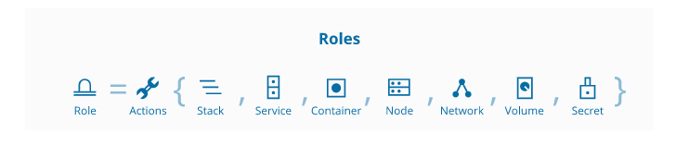
Roles
Docker Universal Control Plane has two types of users: administrators and regular users.
Administrators can make changes to the UCP swarm, while regular users have permissions that range from no access to full control over resources like volumes, networks, images, and containers.
Users are grouped into teams and organizations.
Source: https://docs.docker.com/datacenter/ucp/2.2/guides/access-control/permission-levels/#roles
Notes:
Explain Roles
Role is a feature of Docker Enterprise
Administrators create grants to users, teams, and organizations to give permissions to swarm resources.

Slide 79
Secrets
Docker secrets to centrally manage this data and securely transmit it to only those containers that need access to it.
Secrets are encrypted during transit and at rest in a Docker swarm.
A given secret is only accessible to those services which have been granted explicit access to it, and only while those service tasks are running.
Notes:
Explain Secrets

Slide 80
Secrets
The user can use secrets to manage any sensitive data which a container needs at runtime, but the user doesn’t want to store the sensitive data in the image or in source control. Such sensitive data are:
Usernames and passwords
TLS certificates and keys
SSH keys
Other important data, such as the name of a database or internal server
Generic strings or binary content (up to 500 kb in size)
Notes:
Explain the uses of secrets
Note: Docker secrets are only available to swarm services, not to standalone containers. To use this feature, consider adapting your container to run as a service. Stateful containers can typically run with a scale of 1 without changing the container code.

Slide 81
How Docker Manages Secrets
Docker sends the secrets to the swarm manager over a mutual TLS connection when the user adds a secret to the swarm.
The secret is stored in the Raft log, which is encrypted.
The entire Raft log is replicated across the other managers, guaranteeing high availability for secrets.
Notes:
Explain how docker manages secrets

Slide 82
Docker Secret Commands
Command | Description
docker secret create | Creates a secret from a file or STDIN as content
docker secret inspect | Displays detailed information on one or more secrets
docker secret ls | Lists secrets
docker secret rm | Removes one or more secrets
Notes:
Explain docker secret commands

Slide 83
Docker security prevents a compromised container from consuming a large amount of resources for disrupting service or performing malicious activities.
Docker Trusted Registry can scan images in the repositories using Docker Security Scanning.
A client bundle is a group of certificates downloadable directly from the Docker Universal Control Plane (UCP).
Docker secrets centrally manage the sensitive data and securely transmit it to only those containers that need access to it.
Notes:
Read the points in key takeaways

Slide 85
What are UCP client bundles used for?
1
They contain the username and password in an encryted form for authenticating with the UCP.
They are used for client side authentication.
They contain the user's certificate which can be used for authenticating with UCP.
It is used for server authentication.

Slide 86
What are UCP client bundles used for?
1
They contain the username and password in an encryted form for authenticating with the UCP.
They are used for client side authentication.
They contain the user's certificate which can be used for authenticating with UCP.
It is used for server authentication.
c.
Client Bundle is a group of certificates downloadable directly from the Docker Universal Control Plane (UCP).

Slide 87
________ is a collection of nodes that are in the same Docker cluster.
2
Docker daemon
Swarm
Docker Content Trust
Control Groups

Slide 88
________ is a collection of nodes that are in the same Docker cluster.
2
Docker daemon
Swarm
Docker Content Trust
Control Groups
b.
A swarm is a collection of nodes that are in the same Docker cluster.

Slide 89
Which service ensures that the right UCP services are present?
3
ucp-auth-store
ucp-auth-worker
ucp-agent
ucp-reconcile

Slide 90
Which service ensures that the right UCP services are present?
2
ucp-auth-store
ucp-auth-worker
ucp-agent
ucp-reconcile
c.
ucp-agent is the running service that monitors the node and ensures that the right UCP services are present.

Slide 91
What are the best practices for Docker image security?
4
Prefers minimal base images
Configures the notary client
Signs and verifies images to mitigate MITM attack
Uses labels for metadata

Slide 92
What are the best practices for Docker image security? (Select all that apply.)
4
Prefers minimal base images
Configures the notary client
Signs and verifies images to mitigate MITM attack
Uses labels for metadata
a and c.
Preferring minimal base images and signing and verifying images to mitigate MITM attack are the best practices
for Docker image security.

